Slide 1



Slide 2
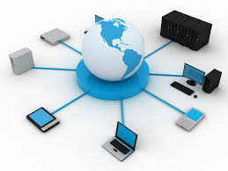
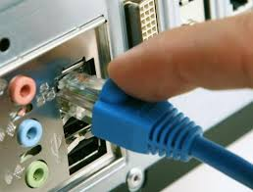
What is a network?
A network is the practice of linking two or more computing devices together for the purpose of sharing data

Slide 3

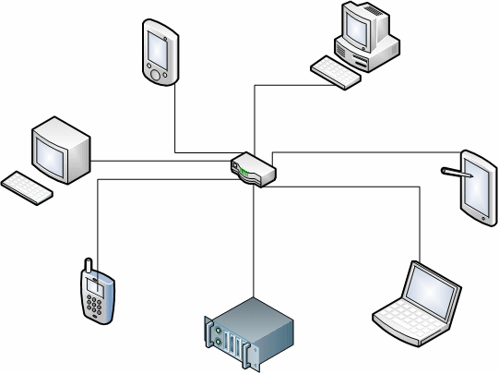
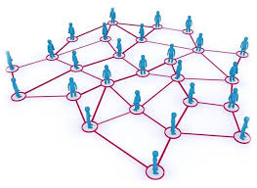
Network diagrams

Slide 4
Requirements for a network connection :
Computers
NIC
Switch
Modem

Slide 5
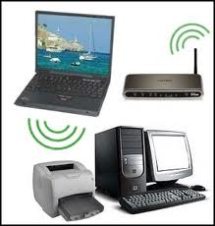
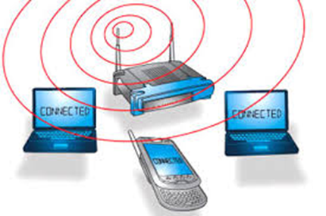
Wireless Networking
Adapters, routers and access points, antennas and repeaters.

Slide 6

Advantages of Networks
Flexible Handling
By allocating different permissions a user users might only be able to access, read and modify certain files.
Increased Storage
One can also design a storage server on the network in order to have a huge storage capacity.

Slide 7
Advantages of Networks
File Sharing
If files are stored on a server and all of its clients share that storage capacity, then it becomes easier to make a file available to multiple users.
Sharing of Resources
The provision of resource sharing. All the computers can be interconnected using a network, and just one modem and printer can efficiently provide the services to several users.

Slide 8

Disadvantages
Security Concerns
Virus and Malware
Lack of Robustness
Needs An Efficient Handler
Lack of Independence

Slide 9

Activity
Learner’s worksheet in Data Files Folder

